Slide 1
Lecture 2 Cloud Computing Fundamentals
Dr. Mohamed ElAraby

Slide 2
Agenda
Motivation for Cloud Computing
Cloud Computing Def.
Principles of Cloud computing (5-4-3)
Five Essential Characteristics
Four Cloud Deployment Models
Three Service Offering Models
Basic Components of Cloud Computing
Cloud service provider

Slide 3
Motivation for Cloud Computing
Enterprises require enormous computing power resources = Costs of Computing resources (HW, SW, networking, storage) + operational + maintain cost
Rent cost < Buying computing infrastructure + operational
Easy to get the required computing resources from provider/supplier when needed.
Paying only for the consumed services.

Slide 4
Motivation for Cloud Computing
Cloud computing is very economical and saves a lot of money.
Losing or damaging, our data and files stay safe, secured as these are not in our local machine.
The cloud represents the Internet-based computing resources, and the accessibility is through some secure support of connectivity.

Slide 5
Motivation for Cloud Computing
Computing solution growing in popularity, especially among individuals and small- / medium-sized companies.
Subscribed to rather than owned.
Increase capacity or add capabilities on the fly without investing in :
New infrastructure,
Training new personnel,
Licensing new software.
Pay-per-use service model.

Slide 6
Cloud Computing Def.
Storing and accessing (data and programs) over the Internet from a remote location or computer instead of our computer’s hard drive.

Slide 7
Cloud Computing Def.
National Institute of Standards & Technology (NIST):
Cloud computing is a model for enabling ubiquitous, convenient, on-demand network access to a shared pool of configurable computing resources (e.g., networks, servers, storage, applications, and services) that can be rapidly provisioned and released with minimal management effort or service provider interaction.

Slide 8
Cloud Computing Def.
Cloud computing from two other perspectives as:
Cloud Computing Is a Service
The simplest thing that any computer does is allow us to store and retrieve information.
Cloud Computing Is a Platform
The World Wide Web (WWW) can be considered as the operating system for all our Internet-based applications.
Such as Google Docs, Microsoft Office 2.0 online.

Slide 9
Principles of Cloud computing (5-4-3)
NIST describe
The five essential characteristic features that promote cloud computing,
The four deployment models that are used to narrate the cloud computing opportunities for customers while looking at architectural models,
The three important and basic service offering models of cloud computing.

Slide 10
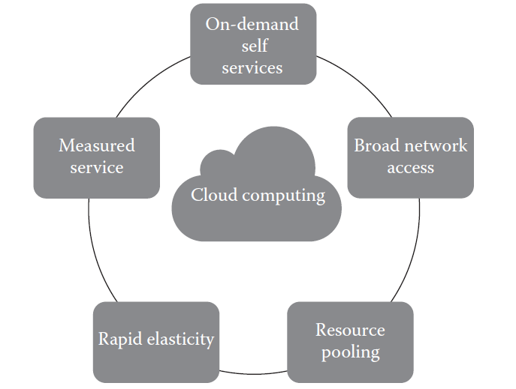
Five Essential Characteristics

Slide 11
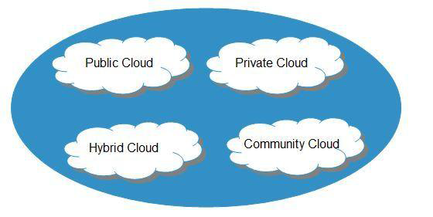
Four Cloud Deployment Models
Deployment models define the type of access to the cloud

Slide 12
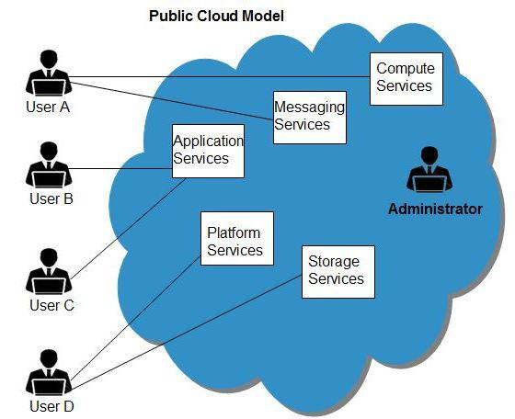
Public computing
The Public Cloud allows systems and services to be easily accessible to general public, e.g., Google, Amazon, Microsoft offers cloud services via Internet.

Slide 13
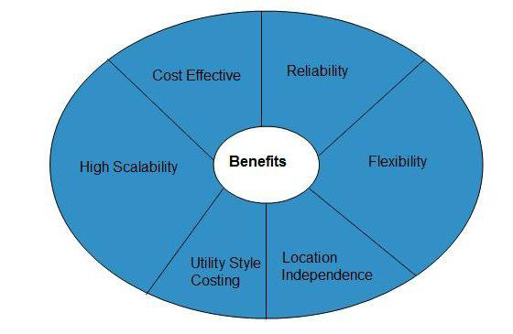
Public Cloud Benefits

Slide 14
Public Cloud Benefits
COST EFFECTIVE
Since public cloud share same resources with large number of consumer, it has low cost.
RELIABILITY
Since public cloud employs large number of resources from different locations, if any of the resource fail, public cloud can employ another one.
FLEXIBILITY
It is also very easy to integrate public cloud with private cloud, hence gives consumers a flexible approach.

Slide 15
Public Cloud Benefits(Cont.)
LOCATION INDEPENDENCE
Since, public cloud services are delivered through Internet, therefore ensures location independence.
UTILITY STYLE COSTING
Public cloud is also based on pay-per-use model and resources are accessible whenever consumer needs it.
HIGH SCALABILITY
Cloud resources are made available on demand from a pool of resources, i.e., they can be scaled up or down according the requirement

Slide 16
Public Cloud Disadvantages
Here are the disadvantages of public cloud model:
LOW SECURITY
In public cloud model, data is hosted off-site and resources are shared publicly, therefore does not ensure higher level of security.
LESS CUSTOMIZABLE
It is comparatively less customizable than private cloud.

Slide 17
Private Cloud
The Private Cloud allows systems and services to be accessible with in an organization. The Private Cloud is operated only within a single organization. However, It may be managed internally or by third-party.

Slide 18
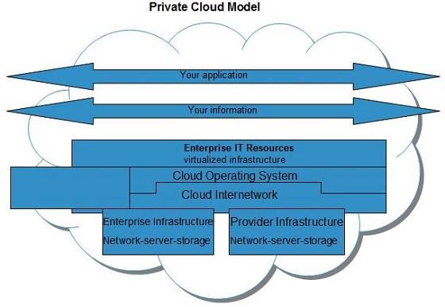
Private cloud computing**

Slide 19
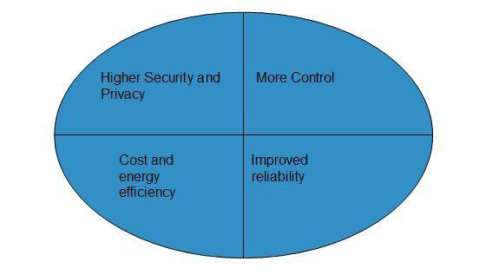
Private Cloud benefits
There are many benefits of deploying cloud as private cloud model. The following diagram shows some of those benefits:

Slide 20
Private Cloud benefits
HIGHER SECURITY AND PRIVACY
Private cloud operations are not available to general public and resources are shared from distinct pool of resources, therefore, ensures high security and privacy.
MORE CONTROL
Private clouds have more control on its resources and hardware than public cloud because it is accessed only within an organization.
COST AND ENERGY EFFICIENCY
Private cloud resources are not as cost effective as public clouds but they offer more efficiency than public cloud.

Slide 21
Private Cloud disadvantages
Here are the disadvantages of using private cloud model:
RESTRICTED AREA
Private cloud is only accessible locally and is very difficult to deploy globally.
INFLEXIBLE PRICING
In order to fulfill demand, purchasing new hardware is very costly.
LIMITED SCALABILITY
Private cloud can be scaled only within capacity of internal hosted resources.

Slide 22
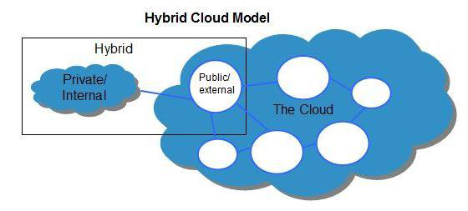
Hybrid Cloud
The Hybrid Cloud is a mixture of public and private cloud. Non-critical activities are performed using public cloud while the critical activities are performed using private cloud.

Slide 23
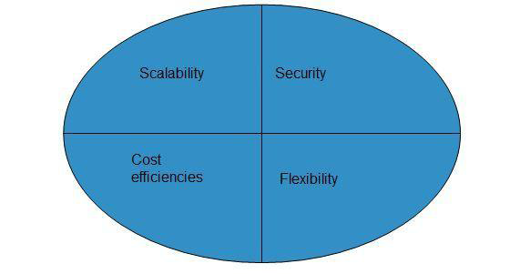
Hybrid Cloud benefits
There are many benefits of deploying cloud as hybrid cloud model. The following diagram shows some of those benefits:

Slide 24
Hybrid Cloud benefits
SCALABILITY
It offers both features of public cloud scalability and private cloud scalability.
FLEXIBILITY
It offers both secure resources and scalable public resources.
COST EFFICIENCIES
Public cloud are more cost effective than private, therefore hybrid cloud can have this saving.
SECURITY
Private cloud in hybrid cloud ensures higher degree of security.

Slide 25
Disadvantages
NETWORKING ISSUES
Networking becomes complex due to presence of private and public cloud.
SECURITY COMPLIANCE
It is necessary to ensure that cloud services are compliant with organization's security policies.

Slide 26
Community Cloud
The Community Cloud allows system and services to be accessible by group of organizations. It shares the infrastructure between several organizations from a specific community. It may be managed internally or by the third-party.

Slide 27
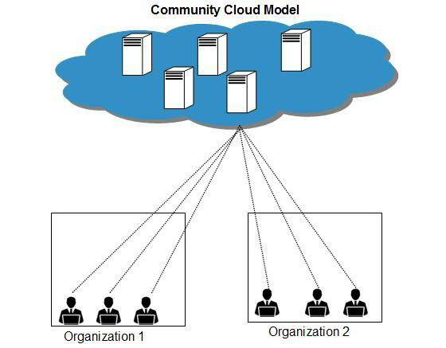

Slide 28
Community Cloud Benefits
There are many benefits of deploying cloud as community cloud model. The following diagram shows some of those benefits:
COST EFFECTIVE
Community cloud offers same advantage as that of private cloud at low cost. Sharing Between Organizations Community cloud provides an infrastructure to share cloud resources and capabilities among several organizations.
SECURITY
Community cloud is comparatively more secure than the public cloud.

Slide 29
Community Cloud Disadvantages
Since all data is housed at one location, one must be careful in storing data in community cloud because it might be accessible by others.
It is also challenging to allocate responsibilities of governance, security and cost.

Slide 30
Service Models
Service Models are the reference models on which the Cloud Computing is based. These can be categorized into three basic service models as listed below:
1. Infrastructure as a Service (IaaS)
2. Platform as a Service (PaaS)
3. Software as a Service (SaaS)

Slide 31
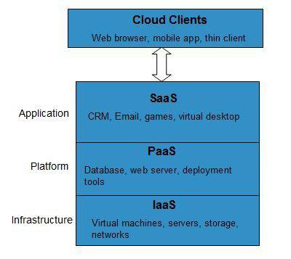
Service model

Slide 32
Software as a Service (SaaS).
SaaS provides both the server hardware and software to an organization without any of the complications of managing an IT system.
The simplest example of SaaS service would be email for an organization.

Slide 33
Software as a Service (Cont..)
SaaS is also known as the On-Demand software because organizations choose the software that they need from a whole host of software offered by cloud service providers.
The early leader in offering SaaS service was IBM in 2003. At that time this service was known as On-Demand software.
The term SaaS evolved over a period of time and came into vogue in 2005 when Amazon launched the Elastic Compute Cloud (EC2).
Today, some of the major commercial SaaS providers are Amazon, Google, Microsoft and SalesForce.

Slide 34
Platform as a Service (PaaS)
Platform as a Service (PaaS) is a cloud based service that gives the subscriber more freedom in the choice of computing platform that they want to use.
The PaaS user must have adequate computer specialists to manage the platform that they subscribe to as opposed to a SaaS user. PaaS brings the same level of flexibility that a cloud platform provides with regard to availability of resources and elasticity of demand.

Slide 35
Platform as a Service (Cont.)
PaaS provides the customer a platform, such as the Windows operating system with the necessary server capacity to run the applications for the customer.
The PaaS cloud service provider manages the system for its upkeep and provisioning of tools such as .NET and Java whereas the customer is responsible for the selection of applications that run on the platform of their choice using the available tools.

Slide 36
Platform as a Service (Cont.)
the customer is responsible for the security challenges associated with the applications that they run.
For example, a customer running a SQL Server database on the platform should be aware of the vulnerabilities of the database system. Hence, the customer should have the expertise to manage such applications on the platform used.

Slide 37
Platform as a Service (Cont.)
The benefit to the customer is that if their hardware needs change or if they require a Linux/UNIX platform for some other applications, then provisioning them takes only a few days as opposed to few weeks to make the new system operational.
Major PaaS cloud service providers are Google App Engine, Salesforce.com and Windows Azure.

Slide 38
Infrastructure as a Service (IaaS)
IaaS provides the customer the same features as PaaS but the customer is fully responsible for the control of the leased infrastructure.
IaaS may be viewed as the computing system of the customer that is not owned by them. Unlike PaaS, IaaS requires the organization to have the necessary people with extensive computing expertise. IaaS is also known as “utility computing” since the organization needs the computing resources but does not invest in it directly but acquires the resources just like it would acquire a utility such as electricity and water.

Slide 39
Infrastructure as a Service (Cont.)
The IaaS customer would be responsible for all security aspects of the system that they use except physical security, which would be handled by the cloud provider.
Amazon, Rackspace, Xerox and IBM are examples of IaaS providers.

Slide 40
Infrastructure as a Service (Cont.)
Typical use for IaaS is when a developer builds an application on a virtual machine of the cloud service provider and customizes the application to the needs of various customers by running them on multiple virtual servers

Slide 41
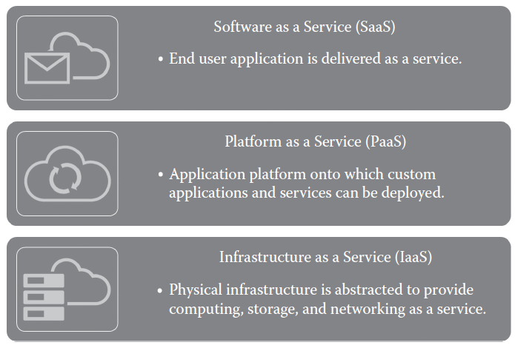
SPI

Slide 42
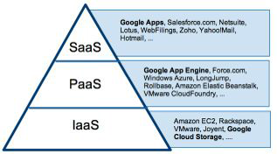

Slide 43
PaaS vs. IaaS
The amount of control that users have:
PaaS allows vendors to manage everything,
IaaS requires more management from the customer side.
Generally speaking, organizations that already have a software package or application for a specific purpose and want to install and run it in the cloud should opt to use IaaS instead of PaaS.

Slide 44
Cloud service provider
“Cloud service provider” is an organization that provides cloud services. The provider may be an external provider or internal to the consumer organization, for example, the IT department.
“Cloud consumer” or “consumer” is an individual or an organization that is a customer of a cloud. Also, a cloud itself may be a customer of another cloud.

Slide 45
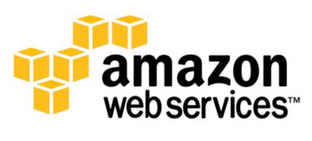



Cloud service providers(Cont.)
Amazon
Google
Microsoft
Salesforce.com
Rackspace

Slide 46
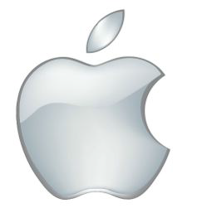




Cloud service providers(Cont.)
6. IBM
EMC
Apple
AT & T
VMware

Slide 47
Basic Components of Cloud Computing
cloud computing components is made of several element such as:
Components
Clients
Datacenter
Distributed server

Slide 48
Clients
Cloud Computing client
Clients are the device that the end user interact to manage their information on cloud.
- they generally divide into 3 categories
MOBILE
THIN
THICK

Slide 49
Clients type
1-MOBILE CLIENTS:
Mobile device include (PDA, SMARTPHONE, or IPHONE)
now these device are portable and work on wireless access of network, through Internet.
2- THIN CLIENTS
Now thin computers are that do not have internal hard drives, but rather the server
do all there work and then display the information.
-

Slide 50
Clients type
3-THICK CLIENTS
Now these are regular computer that do contain internal hard disk, and use web browser
(Firefox, opera, internet explorer)to connect to the cloud.

Slide 51
benefits of using Thin Clients
Some benefits of using Thin Clients are
Lower Hardware cost
Lower IT cost
Security
Less power consumption
Less noise
Ease of replacement of hardware

Slide 52
b) DATACENTRE
Now datacenter is collection of server where application to which you subscribe is housed, it could be a large room in basement, or room full of server which you access through internet.
Now the growing trend in IT sector is using visualization ie (using virtual server) in this software can be installed allowing multiple instances of virtual server to be used in this way we can have half dozen of virtual server running on one physical server.

Slide 53
DATACENTRE
NOTE: (The number of virtual server that can exist on a physical server depend on the SIZE & SPEED of the physical server which runs the application of the virtual server).

Slide 54
c) DISTRIBUTED CLIENTS
Now the server don't have to be housed in same location often server are in dispersed geographically location but to you the cloud subscriber,these server acts if they are humming right away next to each other. This gives the service provider more flexibility in option and security.

Slide 55
c) DISTRIBUTED CLIENTS
FOR EXAMPLE:
Amazon has there cloud solution in servers all the world, if something goes wrong for instance causing a failure on one site, the service will not be stopped it would be accessed through another site also if the cloud needs more hardware they did not need throw more server in the safe room they can add them at another site and simply make it as part of the cloud

Slide 56
Any Question?

